Slide 1

Impact of Climate Change on Maize Agricultural Yield in Kenya
Hosted by: Nakuru, Kenya chapter
Duration: 3 months

Slide 2



Problem Statement
Address is the potential decrease in maize yield due to climate change, which could have severe consequences for food security, economic stability, and the well-being of Kenyan farmers and communities.
Goal of the project is to create;
Project Report
Machine Learning Model
Presentation

Slide 3
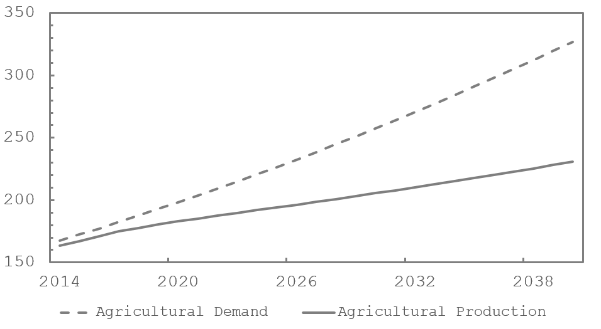
Problem Understanding
90%
of the population relies on it for food, income, and employment.
65%
of the total caloric intake from staple foods.
85%
of the total population consume maize.
In two decades, nearly a third of Southern Africa’s food demand will be met through imports
Source: Institute for security studies (ISS)

Slide 4



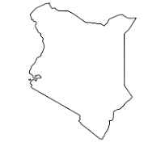
Data Collection
Maize Yield
Soil Data
Climate Data
1980
Kenya
2023

Slide 5

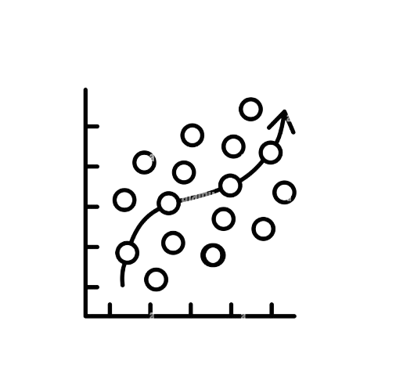


Data Preprocessing
Missing data
Outlier treatment
Correlation
Visualization

Slide 6
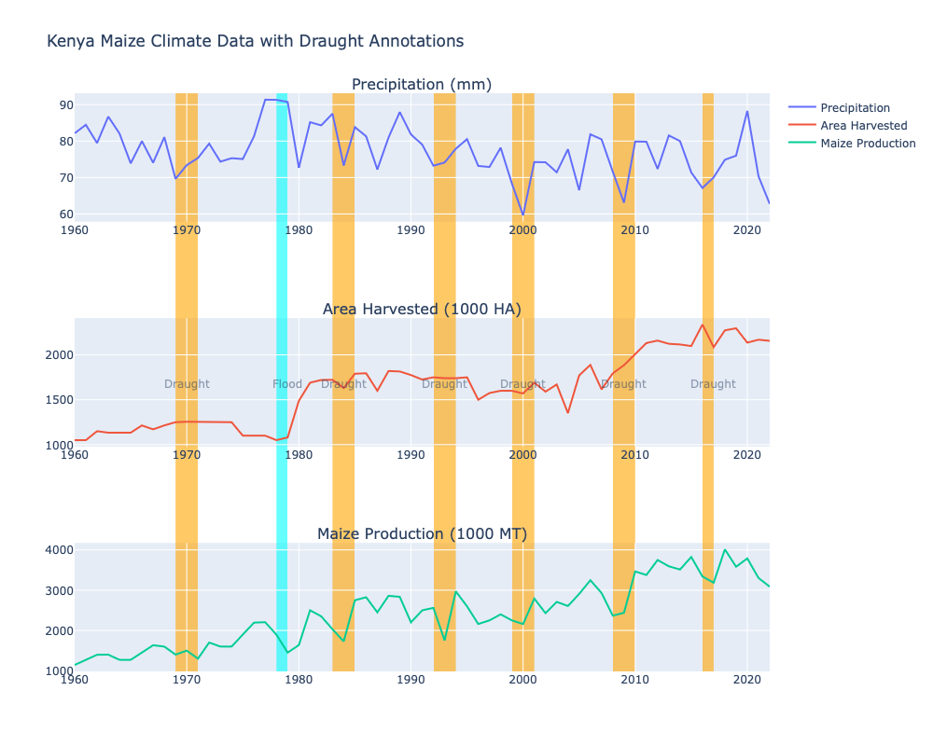
Data Analysis

Slide 7
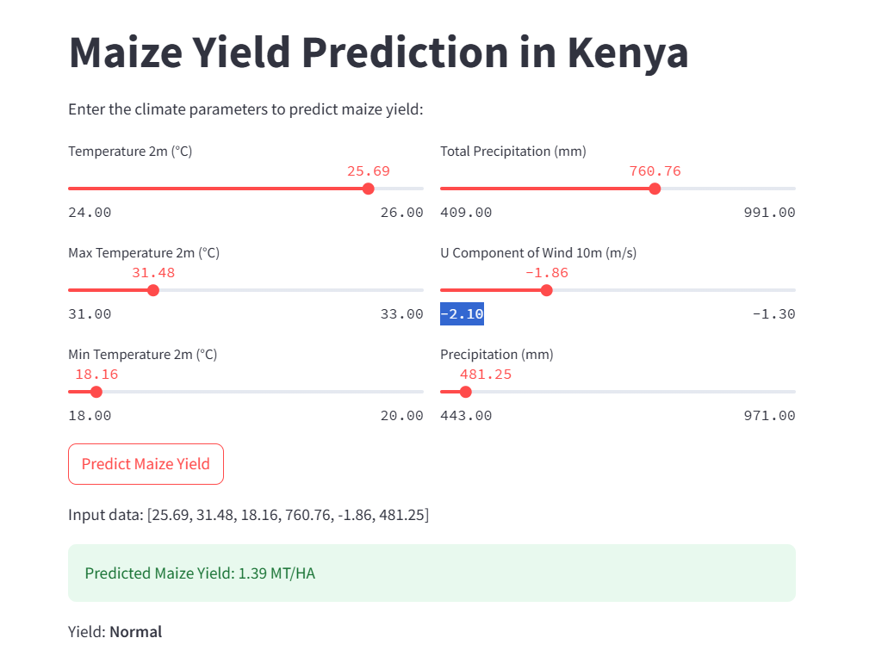
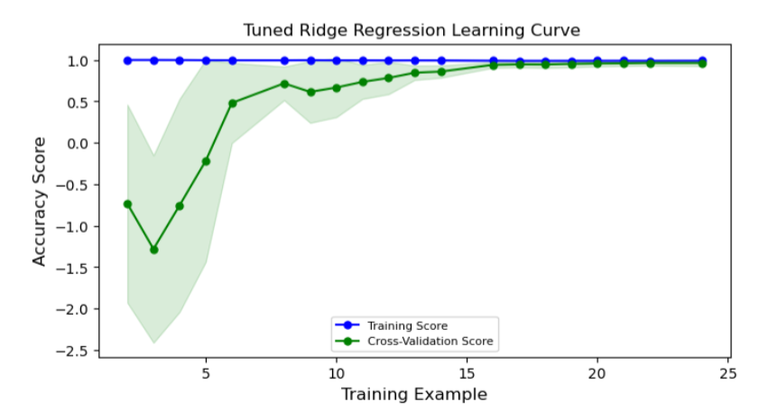
Model Development & Deployment

Slide 8
Thank You!

